Slide 1
CDC: 10 Countries
文件创建于: 10/4/2020 2:27:31 PM

Slide 2
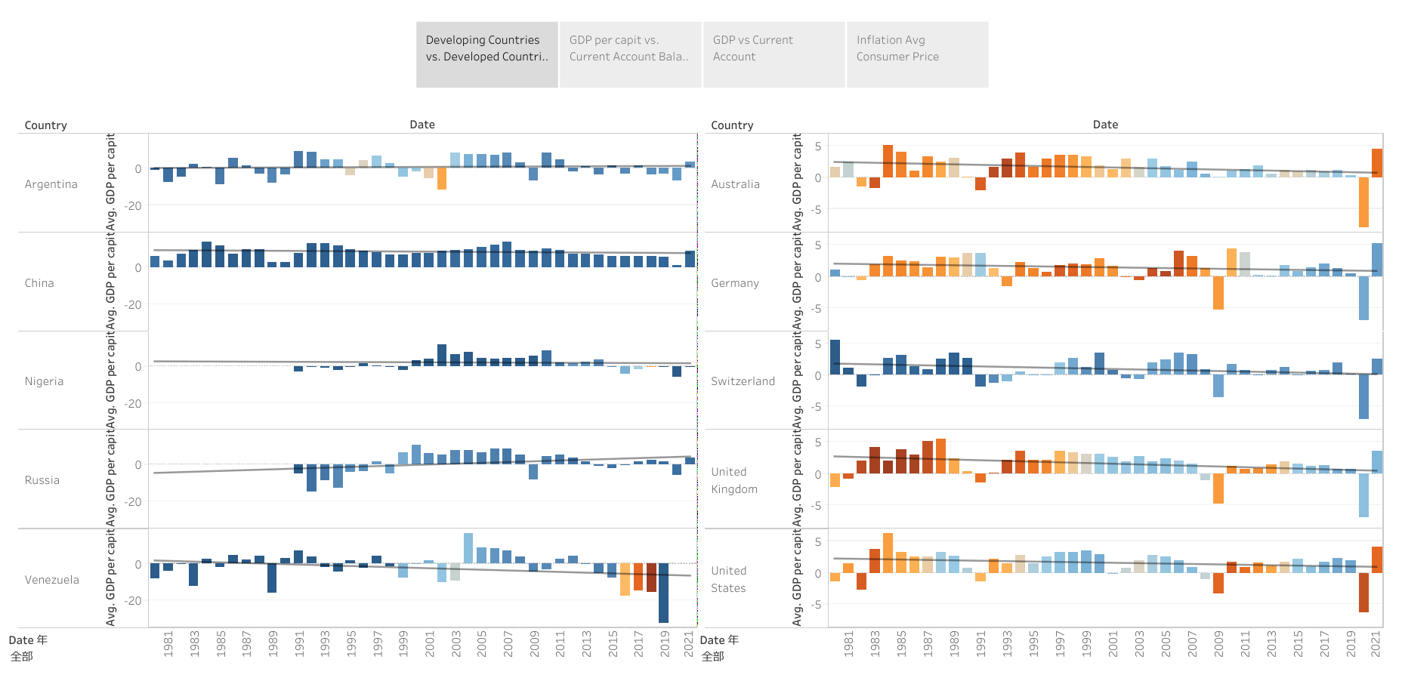

Slide 3
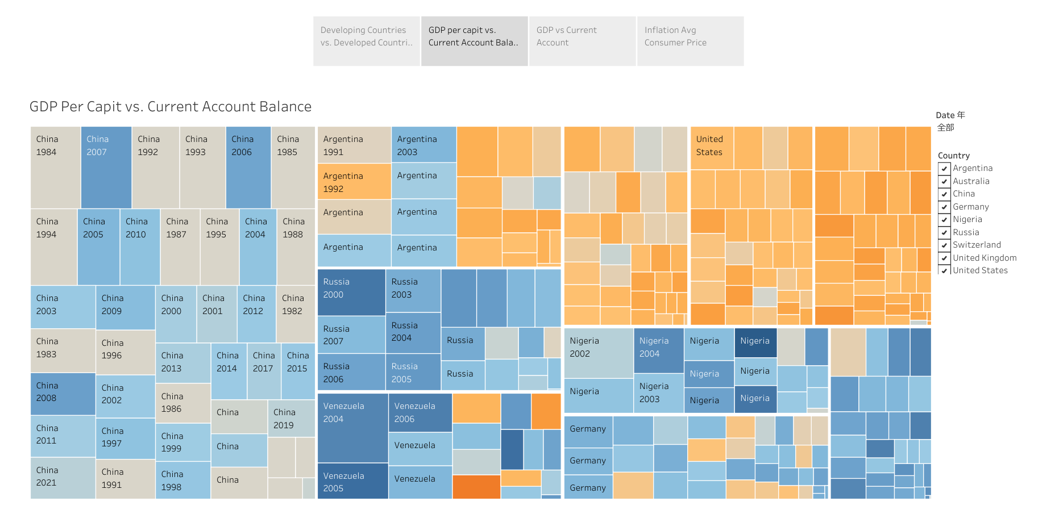

Slide 4
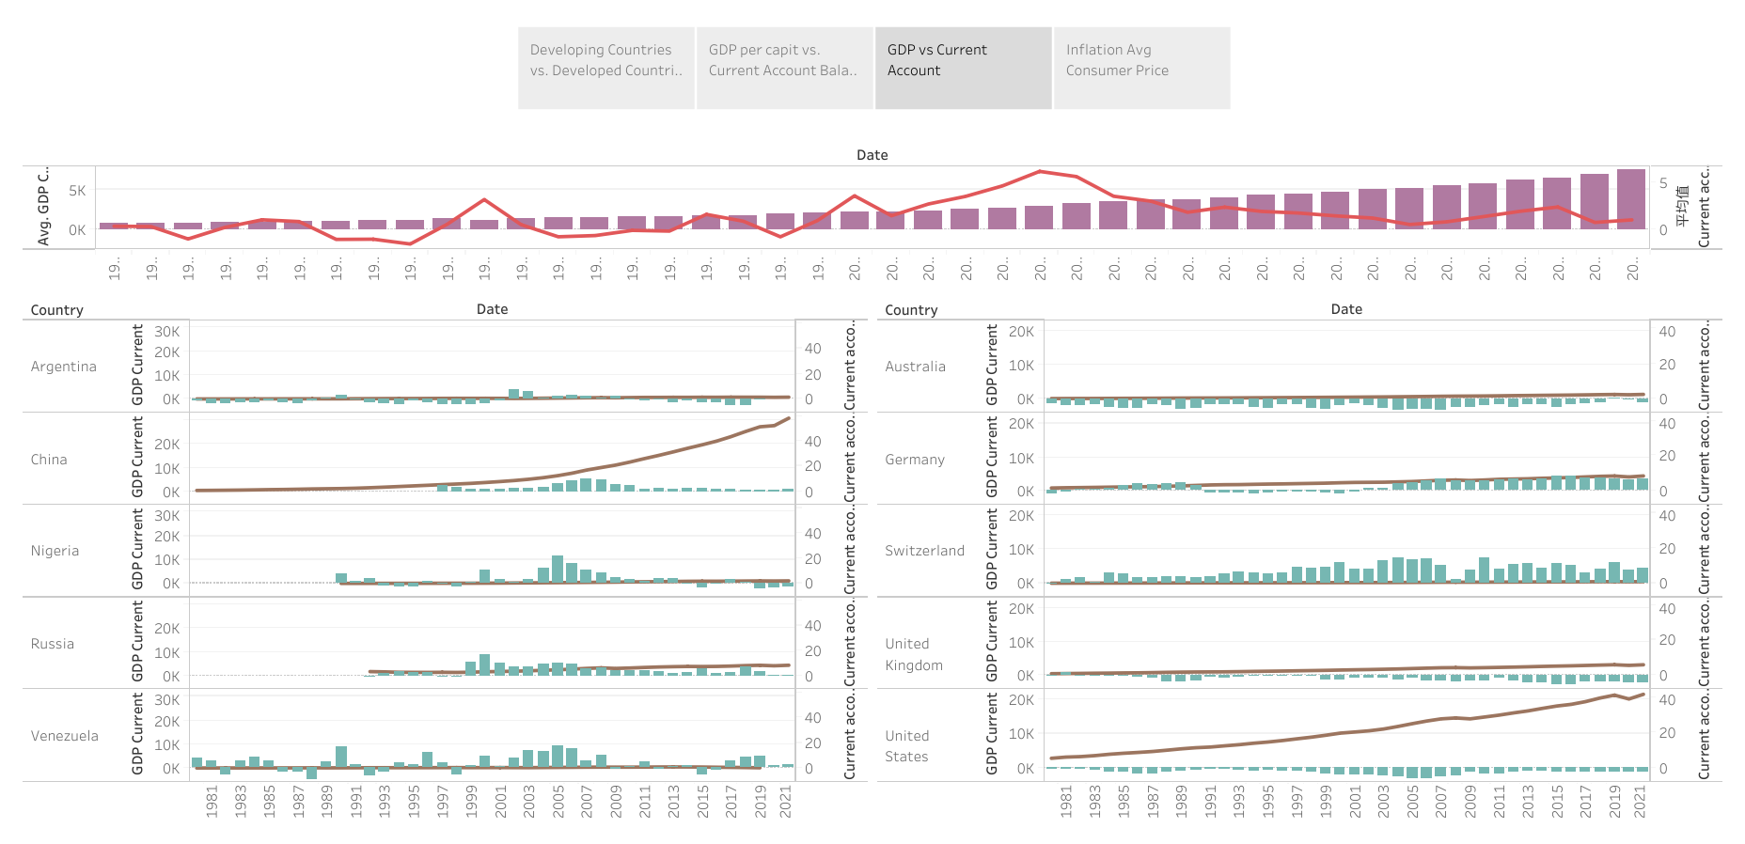

Slide 5
